Slide 1
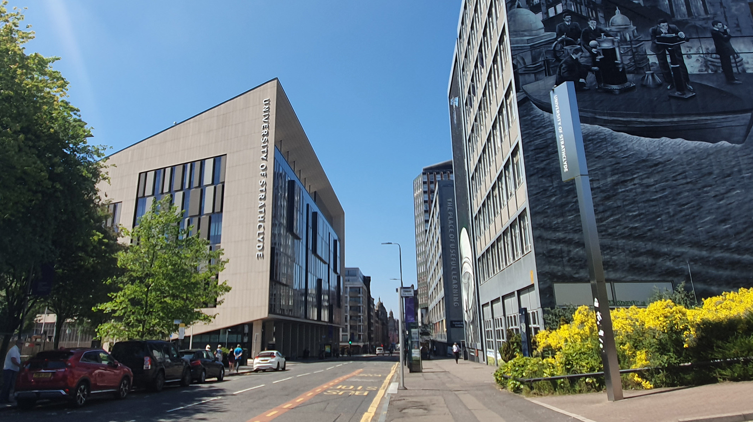

Transform Tools with Applications
Z-transform
carmine.clemente@strath.ac.uk

Slide 2
Introduction
The z-Transform (ZT), will allow us to form complete solutions for LTI discrete systems with general inputs.
The Z-Transform can be appreciated from two perspectives:
from the Laplace Transform of a sampled signal and
from the response of an LTI system to a general discrete input (using the convolution sum).

Slide 3
Z-transform
Consider a continuous signal $x(t)$ that is sampled at discrete time samples $nT$
z is complex valued

Slide 4
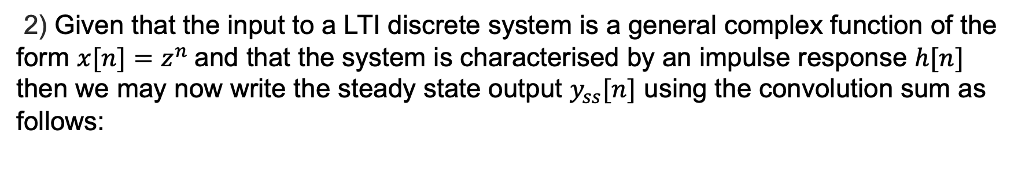
Z-transform
2) Given that the input to a LTI discrete system is a general complex function of the form $x[n]=z^{n}$and that the system is characterised by an impulse response $h[n]$ then we may now write the steady state output $y_{ss}[n]$ using the convolution sum as follows:

Slide 5
One-Sided Z-Transform
In general DSP courses we concentrate on causal signals and thus $x[n]=0$for $n < 0$and define the one-sided Z-Transform as follows:
The Region of Convergence (ROC) is defined as those values of z for which the summation converges.

Slide 6
One-Sided Z-Transform
Example 1: ZT[u[n]]
Outside the unit circle
ROC if |z-1 | < 1 or |z| > 1.
Example 2: ZT[ (0.5)^{n} u[n] ]
Inside the unit circle
ROC |z| > 0.5

Slide 7
Z-Transform table

Slide 8
Z-Transform Exercises

Slide 9
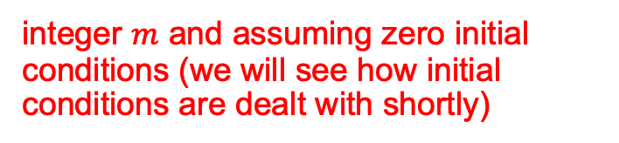
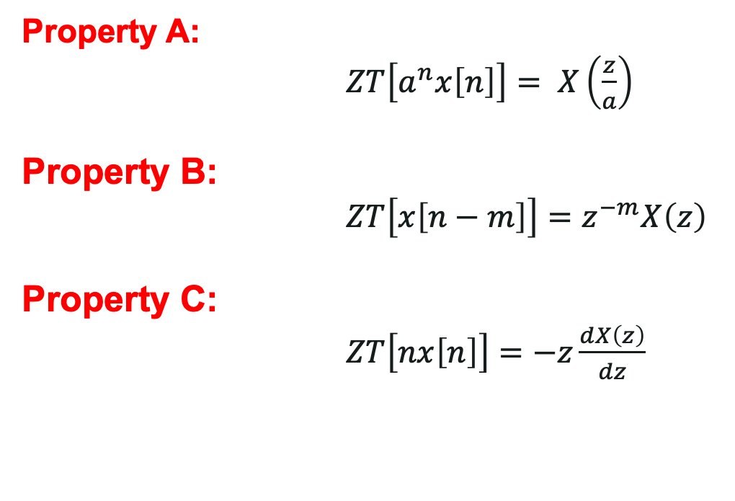
Z-Transform – Useful Properties
The z-transform has a number of properties, we will use only few of them
Property A:
$ZT\left[a^{n}x\left[n\right]\right]= X\left(\frac{z}{a}\right)$
Property B:
$ZT\left[x\left[n−m\right]\right]=z^{−m}X\left(z\right)$
Property C:
$ZT\left[nx\left[n\right]\right]=−z\frac{dX\left(z\right)}{dz}$
integer $m$ and assuming zero initial conditions (we will see how initial conditions are dealt with shortly)

Slide 10
Inverse z-transform
The inverse ZT is carried out with the use of the supplied ZT tables and knowledge of the ZT properties (see lecture notes).
To be able to carry out the inverse ZT it will be important to arrange the expressions in a form that appears in the ZT tables.
Partial Fractions are used for this task.
Let us see examples of the two most common partial fractions that you will encounter.

Slide 11
Inverse z-transform
Type 1: Distinct roots of the Characteristic Equation
Find A – B and C
From the table

Slide 12
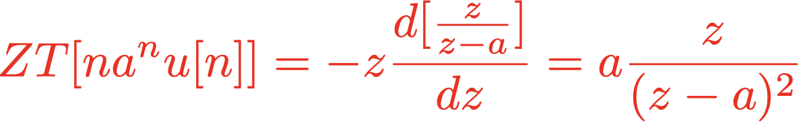
Inverse z-transform
Type 2: Multiple roots of the Characteristic Equation
Find A – B and Cs

Slide 13
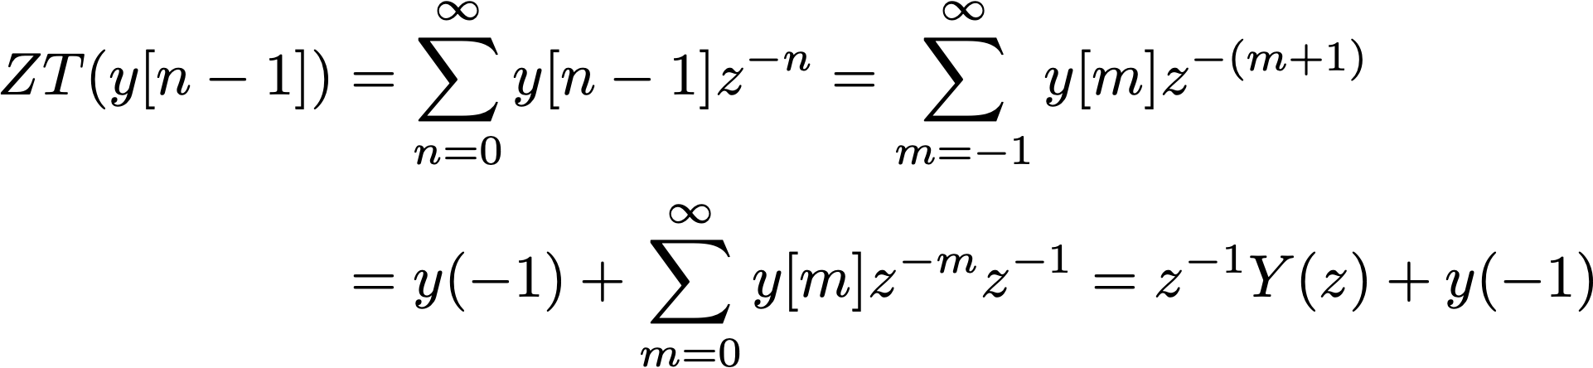
Z-transform of Delays and Convolution sums
Delays and Conv. Sums resulted very relevant when characterizing Discrete LTI Systems.
Thus transforming the shift to the ZT domain produces a simple algebraic result along with the initial condition explicitly stated
Delay
Recall when we used $z$ as the shift operator…
$y(−1)$is the initial condition allowing us to analyse potential transients

Slide 14
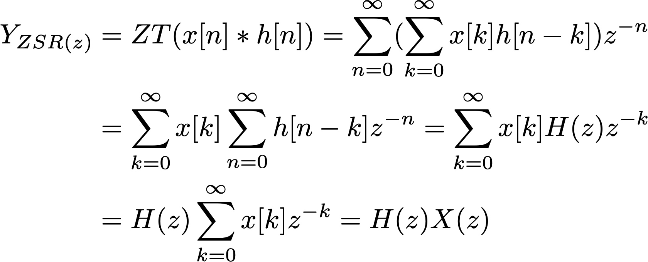
Z-transform of Delays and Convolution sums
Convolution sum
Let us consider a causal system with zero initial condition
No initial conditions ZSR
So the convolution sum in the z domain is the product of the z-transforms.

Slide 15
Z-transform to analyze Discrete Systems
The z-transform domain is very useful in solving difference equations;
So we can apply it to analyze discrete systems that we now know are defined by difference equations;
Let us start with an example and then we generalize our observations.

Slide 16
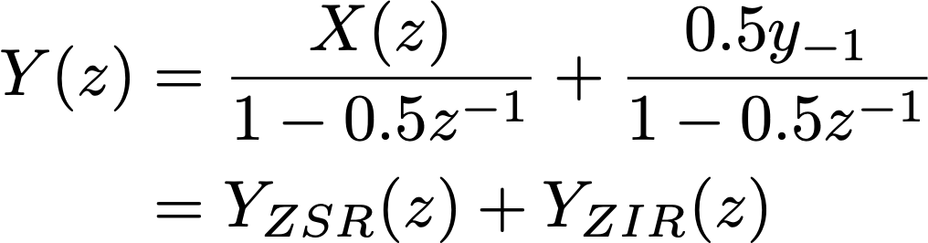
Z-transform to analyze Discrete Systems
Example
Let us consider a system and see how the z-transform is useful to analyze a discrete system:
Its z-transform is:
We can now observe the two responses separately

Slide 17
Z-transform to analyze Discrete Systems
Example- continued
So we get that
and inverting the z-transform we obtain

Slide 18
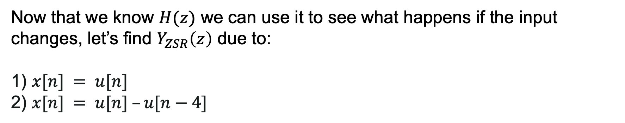
Z-transform to analyze Discrete Systems
Example- continued
Now that we know $H(z)$ we can use it to see what happens if the input changes, let’s find $Y_{ZSR}\left(z\right)$ due to:
1) $x[n] = u[n]$
2) $x[n] = u[n] –u[n−4]$

Slide 19
Z-transform to analyze Discrete Systems
Example- continued
1)
We did not have to compute a convolution!

Slide 20
Z-transform to analyze Discrete Systems
Example- continued
2) For $x[n] = u[n] –u[n−4]$ , do not forget that we are dealing with LTI systems, so:

Slide 21
Z-transform to analyze Discrete Systems
Let us consider now a General Discrete system and take its z-transform

Slide 22
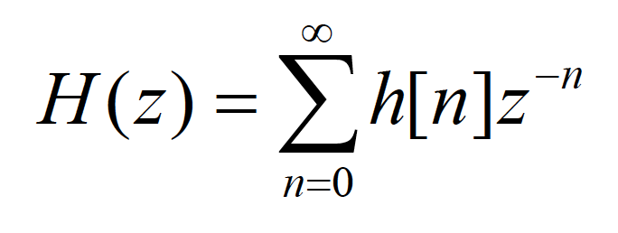
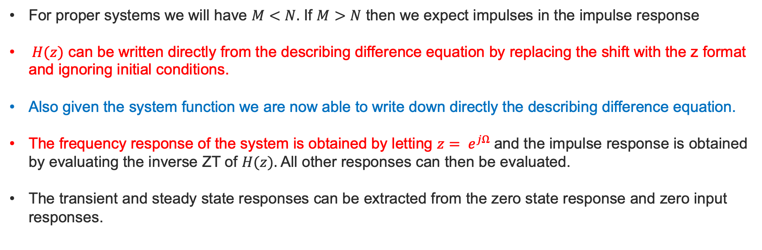
Z-transform to analyze Discrete Systems
SYSTEM FUNCTION
For proper systems we will have $M<N.$ If $M>N$ then we expect impulses in the impulse response
$H(z)$ can be written directly from the describing difference equation by replacing the shift with the z format and ignoring initial conditions.
Also given the system function we are now able to write down directly the describing difference equation.
The frequency response of the system is obtained by letting $z= e^{jΩ}$ and the impulse response is obtained by evaluating the inverse ZT of $H(z).$All other responses can then be evaluated.
The transient and steady state responses can be extracted from the zero state response and zero input responses.

Slide 23
Transform Tools with Applications
Discrete Time Fourier Transform
carmine.clemente@strath.ac.uk

Slide 24
Z-transform and Discrete time Fourier Transform

Slide 25

$H(Ω):$the Discrete Time Fourier Transform
Z-Plane
1

Slide 26
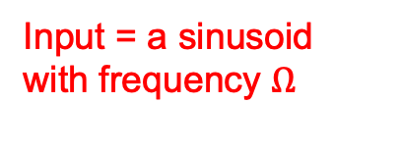
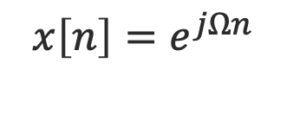
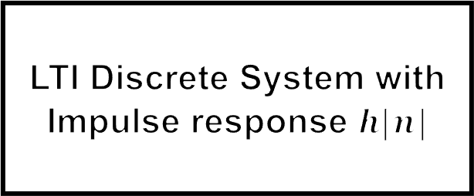
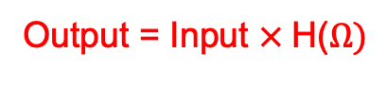
$H(Ω):$the Discrete Time Fourier Transform
Output = Input $×$H($Ω)$
LTI Discrete System with Impulse response $h[n]$
y_{ss}[n]: Steady State Frequency Response
$$x\left[n\right]=e^{jΩn}$$
Input = a sinusoid with frequency $Ω$

Slide 27

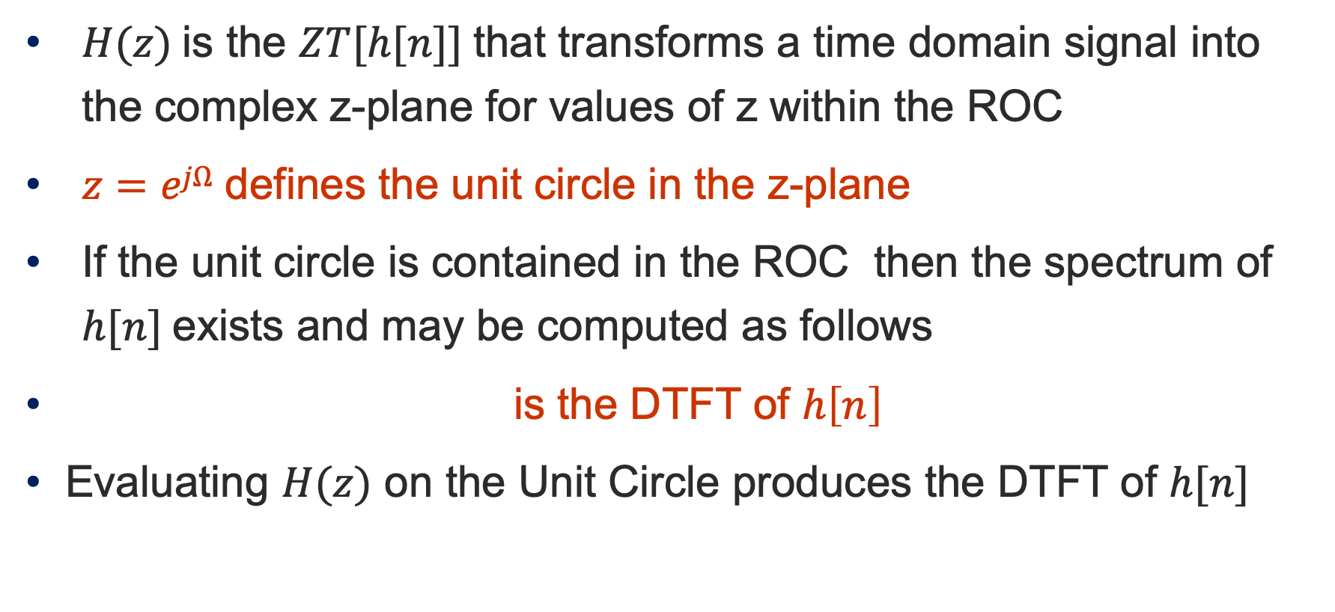
$H(Ω):$the Discrete Time Fourier Transform
$H(z)$is the $ZT[h[n]]$that transforms a time domain signal into the complex z-plane for values of z within the ROC
$z=ejΩ$defines the unit circle in the z-plane
If the unit circle is contained in the ROC then the spectrum of $h[n]$exists and may be computed as follows
is the DTFT of $h\left[n\right]$
Evaluating $H(z)$ on the Unit Circle produces the DTFT of $h[n]$

Slide 28
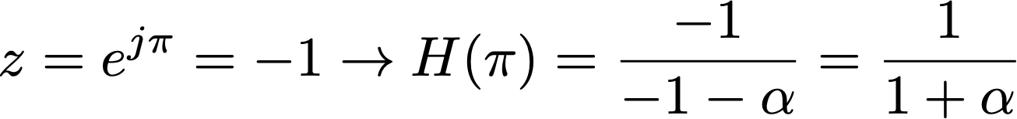
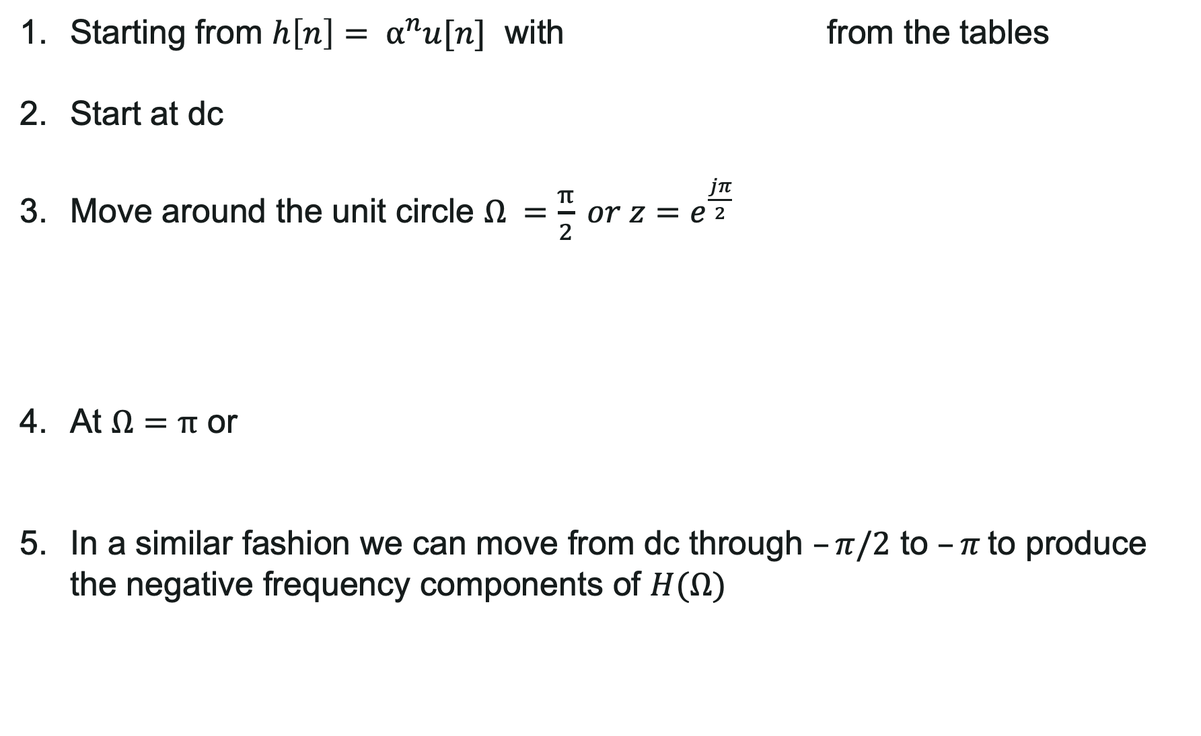
Example of evaluating DTFT from the z-plane
Starting from $h\left[n\right]= α^{n}u[n]$ with from the tables
Start at dc
Move around the unit circle $Ω =\frac{π}{2} or z=e^{\frac{jπ}{2}}$
At $Ω=π$ or
In a similar fashion we can move from dc through $–π/2$ to $–π$to produce the negative frequency components of $H(Ω)$

Slide 29
Example of evaluating DTFT from the z-plane
Let us consider the particular case
;
;
;

Slide 30
Example of evaluating DTFT from the z-plane
Ω | H(Ω) | |H(Ω)| Mag | <[H(Ω)] Phase
-π | 1/(1+0.5) | 0.667 | 0
-3π/4 | 1/[1-0.5{-.707+j.707}] | 0.715 | 0.255
-π/2 | 1/[1-0.5(j)] | 0.894 | 0.464
-π/4 | 1/[1-0.5{.707+j.707}] | 1.357 | 0.5
0 | 1/(1-0.5) | 2 | 0
π/4 | 1/[1-0.5{.707-j.707}] | 1.357 | -0.5
π/2 | 1/[1-0.5(-j)] | 0.894 | -0.464
3π/4 | 1/[1-0.5{-.707-j.707}] | 0.715 | -0.255
π | 1/(1+0.5) | 0.667 | 0

Slide 31
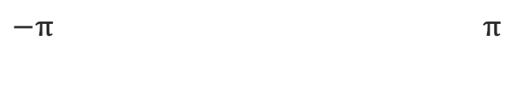

Sketching the Magnitude and Phase response
$−π$ $π$
$−π$ $π$

Slide 32
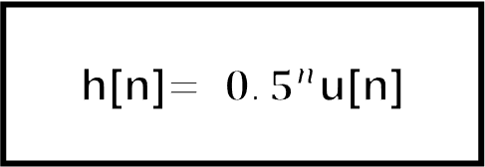
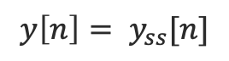
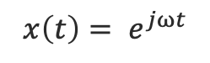
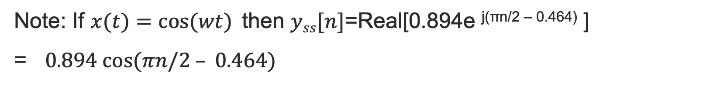
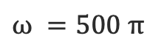
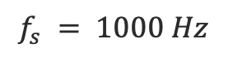
How to use the Freq. Response plots
$ω =500 π$
$$f_{s} = 1000 Hz$$
$$x\left(t\right)= e^{jωt}$$
Sampler
h[n]$= 0.5^{n}$u[n]
$$y\left[n\right]= y_{ss}[n]$$
Note: If $x(t)=cos⁡(wt)$then $yss[n]$=Real[0.894e ^{j(πn/2 – 0.464)} ]
= $0.894 cos⁡(πn/2 – 0.464)$

Slide 33
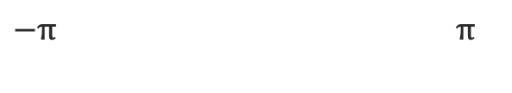

How to use the Freq. Response plots
$−π$ $π$
$−π$ $π$

Slide 34
Some Common DTFTs

Slide 35
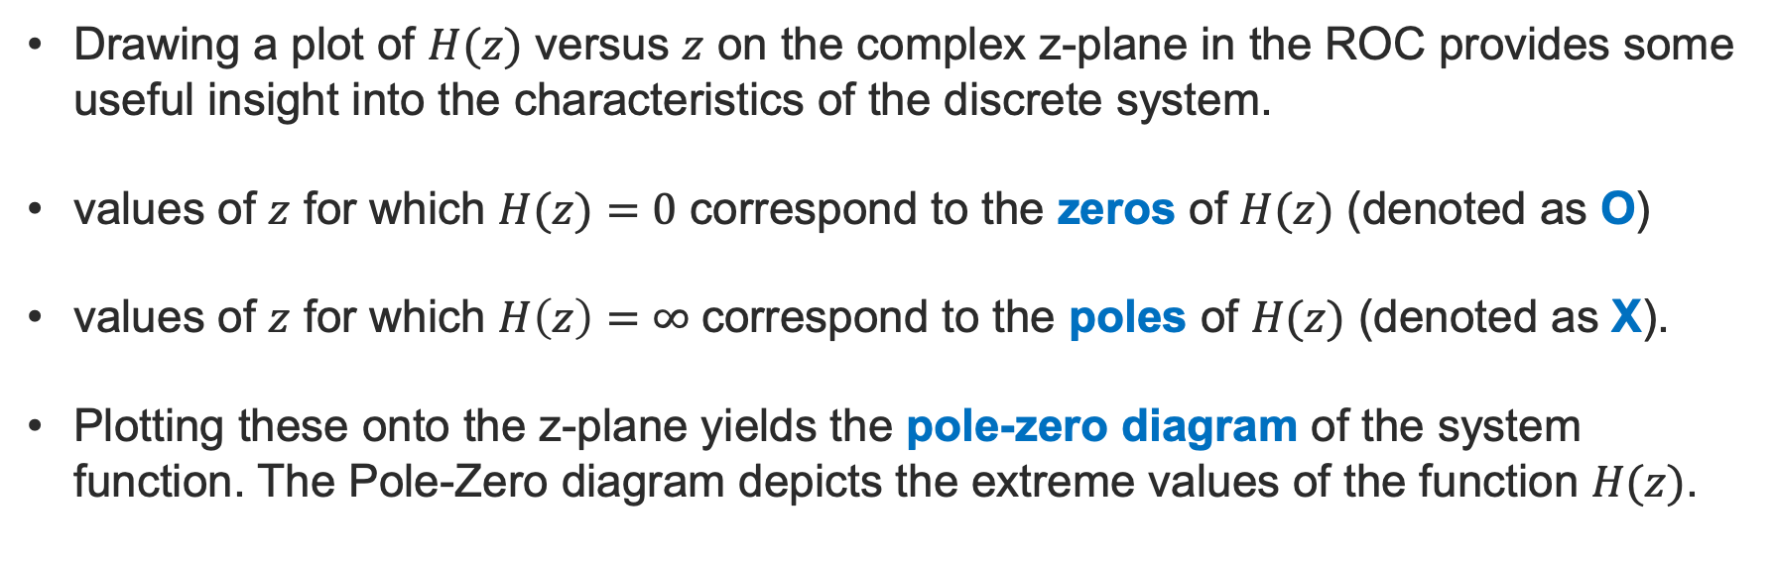
Poles and Zeros of the system function
Drawing a plot of $H(z)$ versus $z$ on the complex z-plane in the ROC provides some useful insight into the characteristics of the discrete system.
values of $z$ for which $H(z)=0$ correspond to the zeros of $H(z)$ (denoted as O)
values of $z$ for which $H\left(z\right)=∞$correspond to the poles of $H(z)$ (denoted as X).
Plotting these onto the z-plane yields the pole-zero diagram of the system function. The Pole-Zero diagram depicts the extreme values of the function $H(z)$.

Slide 36
Poles and Zeros of the system function
Im(z)
z-plane
o
x
1
-2
-0.5
Real(z)

Slide 37
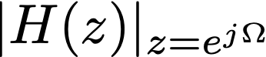
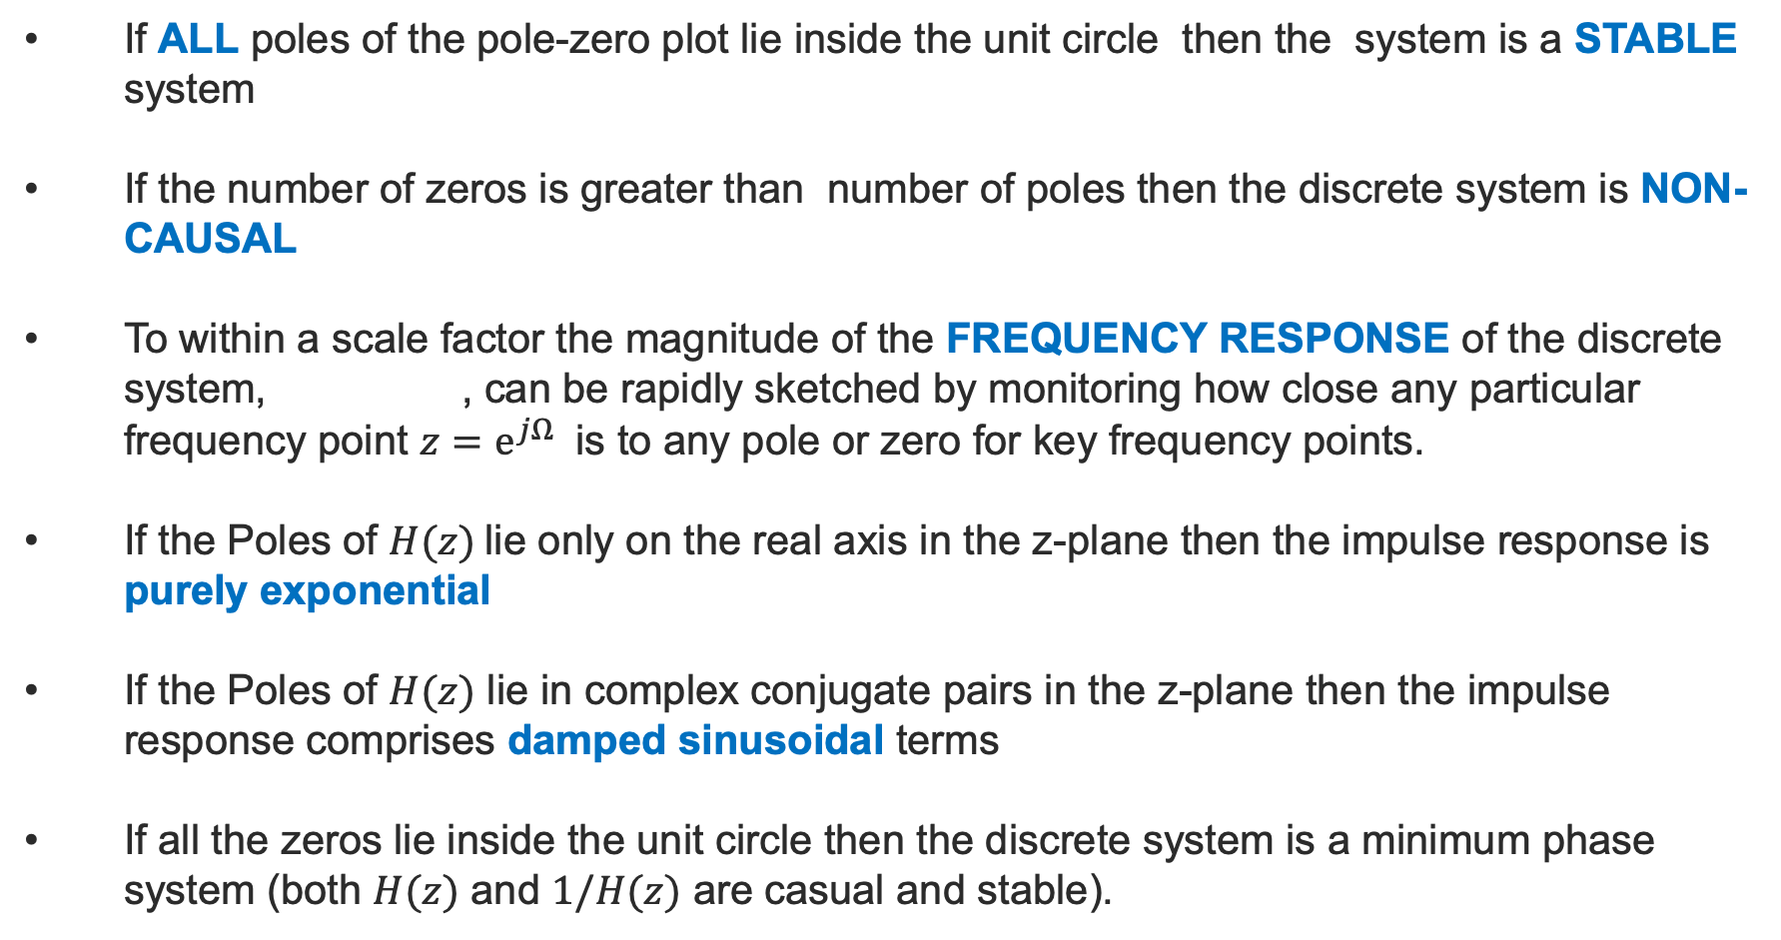
Poles and Zeros
If ALL poles of the pole-zero plot lie inside the unit circle then the system is a STABLE system
If the number of zeros is greater than number of poles then the discrete system is NON-CAUSAL
To within a scale factor the magnitude of the FREQUENCY RESPONSE of the discrete system, , can be rapidly sketched by monitoring how close any particular frequency point $z=e^{jΩ}$ is to any pole or zero for key frequency points.
If the Poles of $H(z)$lie only on the real axis in the z-plane then the impulse response is purely exponential
If the Poles of $H(z)$ lie in complex conjugate pairs in the z-plane then the impulse response comprises damped sinusoidal terms
If all the zeros lie inside the unit circle then the discrete system is a minimum phase system (both $H(z)$ and $1/H(z)$ are casual and stable).

Slide 38
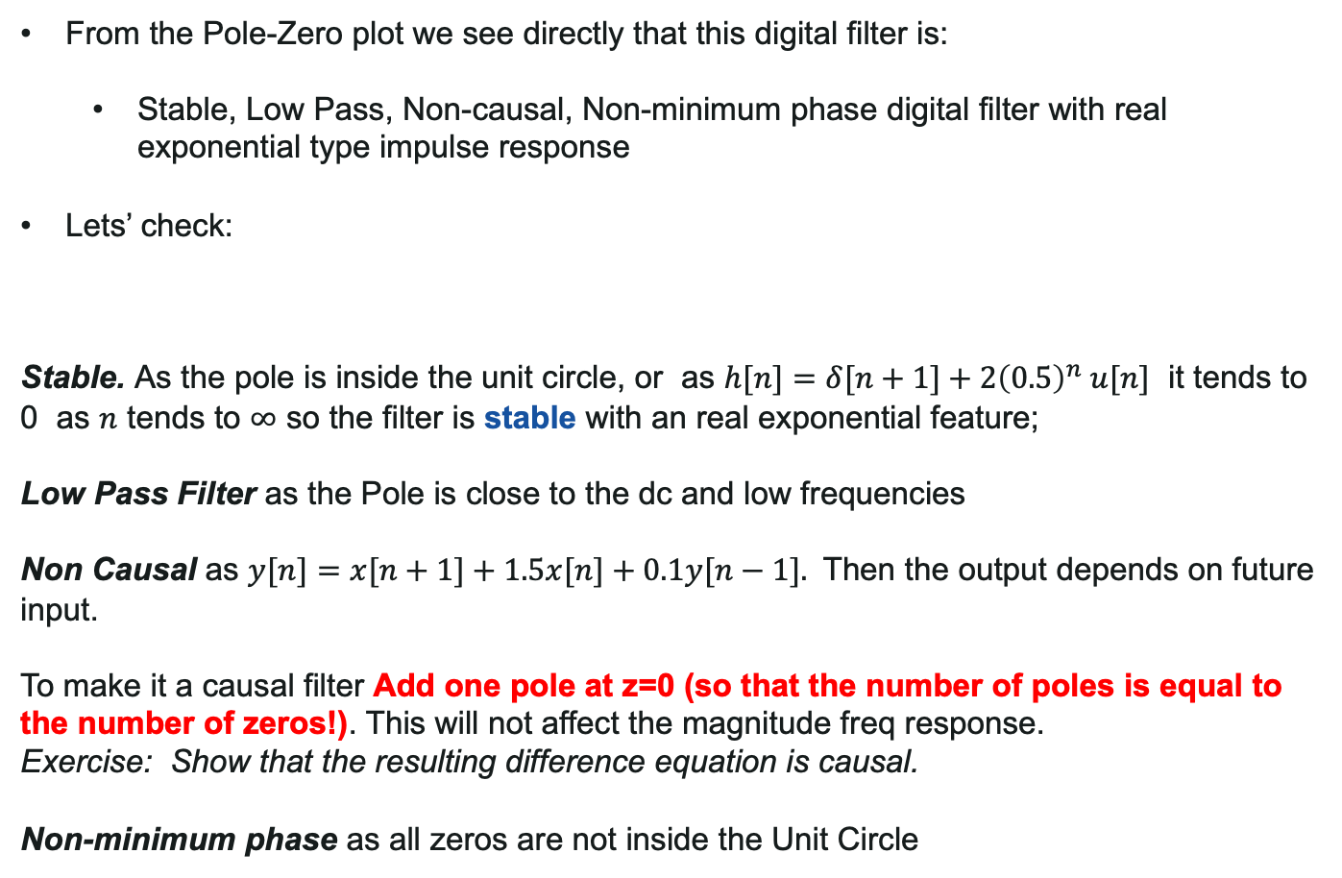
Poles and Zeros
From the Pole-Zero plot we see directly that this digital filter is:
Stable, Low Pass, Non-causal, Non-minimum phase digital filter with real exponential type impulse response
Lets’ check:
Stable. As the pole is inside the unit circle, or as $h[n]=δ[n+1]+2{\left(0.5\right)}^{n} u[n]$ it tends to 0 as $n$ tends to $∞$ so the filter is stable with an real exponential feature;
Low Pass Filter as the Pole is close to the dc and low frequencies
Non Causal as $y[n]=x[n+1]+1.5x[n]+0.1y[n−1].$ Then the output depends on future input.
To make it a causal filter Add one pole at z=0 (so that the number of poles is equal to the number of zeros!). This will not affect the magnitude freq response.
Exercise: Show that the resulting difference equation is causal.
Non-minimum phase as all zeros are not inside the Unit Circle
Im(z)
z-plane
1
o
o
x
0.5
-1.5
Real(z)

Slide 39
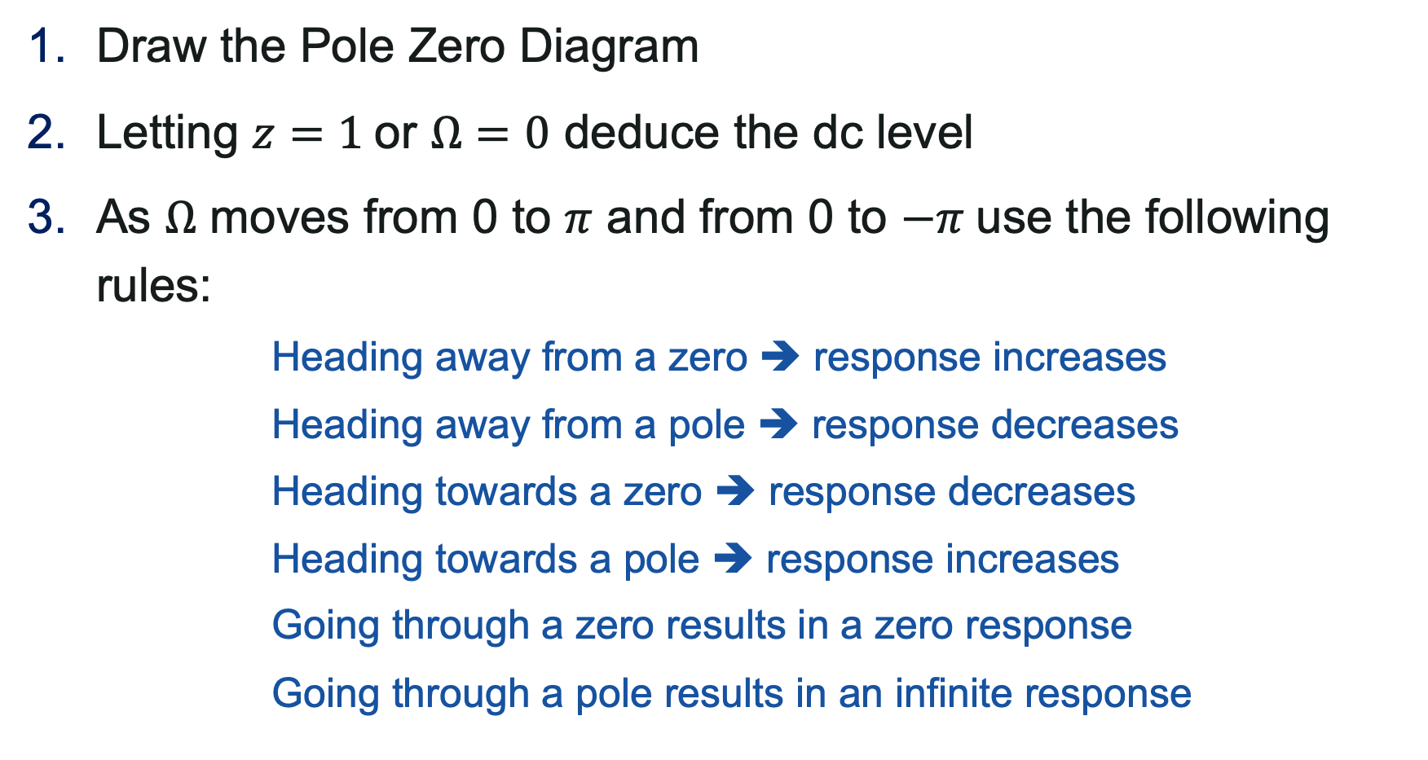

Sketching $H\left(Ω\right)$
Draw the Pole Zero Diagram
Letting $z=1$or $Ω=0$ deduce the dc level
As $Ω$ moves from 0 to $π$ and from 0 to $−π$use the following rules:
Heading away from a zero ➔ response increases
Heading away from a pole ➔ response decreases
Heading towards a zero ➔ response decreases
Heading towards a pole ➔ response increases
Going through a zero results in a zero response
Going through a pole results in an infinite response

Slide 40
Sketching Examples

Slide 41
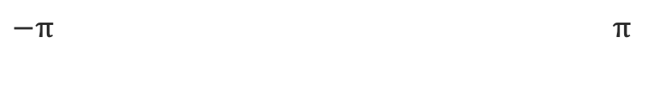
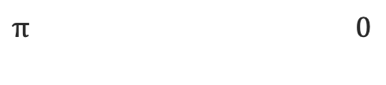
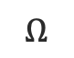
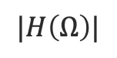
Sketching Examples
Im(z)
z-plane
1
o
x
$π$ $0$
$$|H\left(Ω\right)|$$
0
0.5
Real(z)
$−π$ $π$
$$Ω$$
Check it in matlab – freqz(b,a)

Slide 42
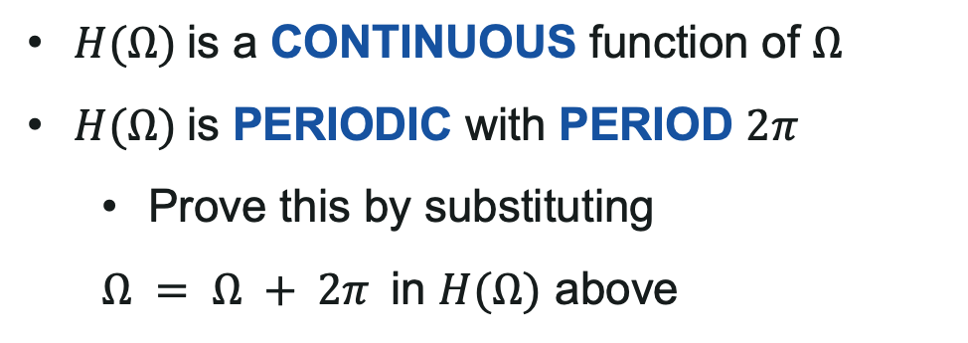

Characteristics of $H(Ω)$
$H(Ω)$is a CONTINUOUS function of $Ω$
$H(Ω)$is PERIODIC with PERIOD $2π$
Prove this by substituting
$Ω = Ω + 2π$in $H(Ω)$ above

Slide 43
Time and Frequency Windows

Slide 44
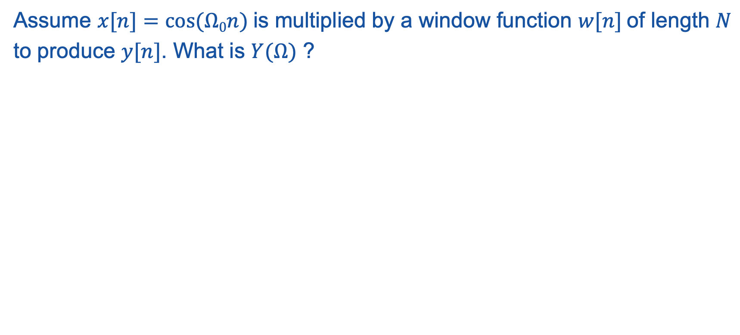
Signal Acquisition
Generally speaking, when a signal is acquired we are applying implicitly a window in time or in frequency;
Assume $x[n]=cos⁡(Ω0n)$is multiplied by a window function $w[n]$of length $N$ to produce $y[n]$. What is $Y(Ω)$ ?
“The spectrum of a windowed portion of a sinusoid comprises shifted copies of the spectrum of the window centred at the location of the sinusoid”

Slide 45
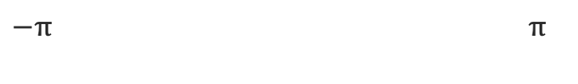
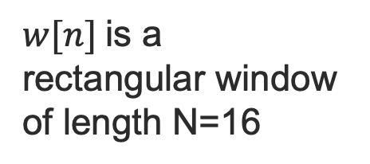
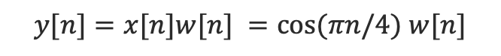
Signal Acquisition
$$y[n]=x[n]w[n] =cos⁡(πn/4) w[n]$$
$w[n]$is a rectangular window of length N=16
Max 16
$−π$ $π$

Slide 46
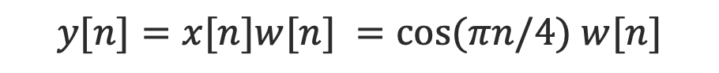
Signal Acquisition
$$y[n]=x[n]w[n] =cos⁡(πn/4) w[n]$$
cos(πn/4)= [ exp(jπn/4) + exp(-jπn/4) ]/2

Slide 47
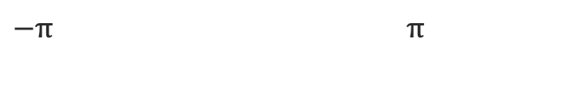

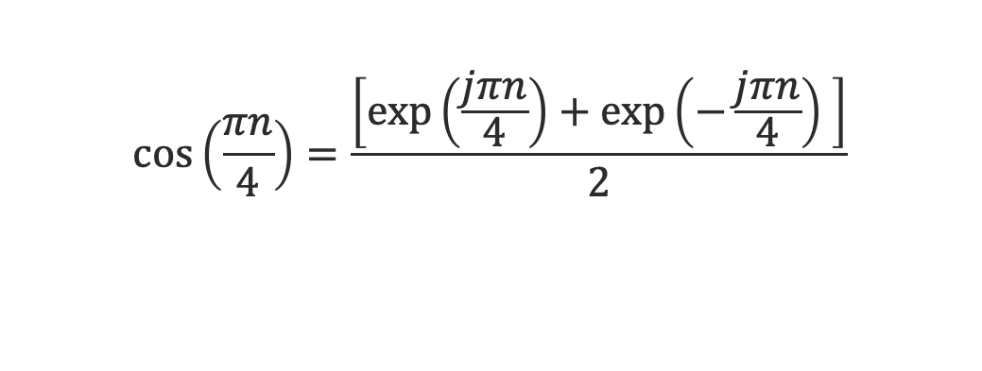
Signal Acquisition
$$\cos\left(\frac{πn}{4}\right)=\frac{\left[\exp\left(\frac{jπn}{4}\right)+\exp\left(−\frac{jπn}{4}\right) \right]}{2}$$
$−π$ $π$
$−π$ $π$

Slide 48
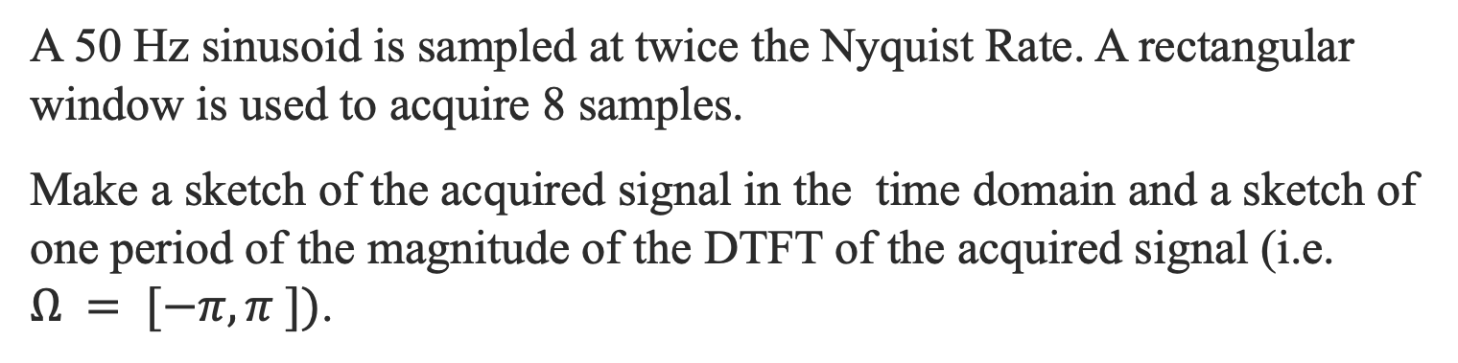
Exercise
A 50 Hz sinusoid is sampled at twice the Nyquist Rate. A rectangular window is used to acquire 8 samples.
Make a sketch of the acquired signal in the time domain and a sketch of one period of the magnitude of the DTFT of the acquired signal (i.e. $Ω = [−π,π ])$.

Slide 49
Summary
Through the z and the DTF transforms we can characterise easily discrete systems responses;
Understanding the characteristics of the responses makes easy also to design systems with desired characteristics;
Something to be taken into account is the fact that a windowing process is inevitable and affects the responses observed.

